Slide 1
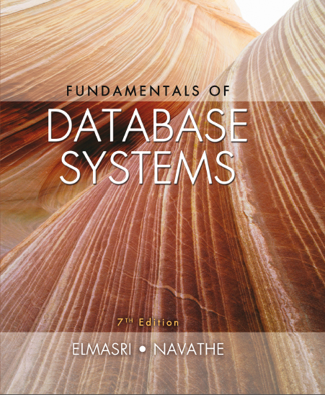
Fundamentals of Database Systems
Seventh Edition
Chapter 2
Database System Concepts and Architecture
Copyright © 2016, 2011, 2007 Pearson Education, Inc. All Rights Reserved
Notes:
If this PowerPoint presentation contains mathematical equations, you may need to check that your computer has the following installed:
1) MathType Plugin
2) Math Player (free versions available)
3) NVDA Reader (free versions available)

Slide 2
Learning Objectives
2.1 Data Models and Their Categories
2.2 History of Data Models
2.3 Schemas, Instances, and States
2.4 Three-Schema Architecture
2.5 Data Independence
2.6 D B M S Languages and Interfaces
2.7 Database System Utilities and Tools
2.8 Centralized and Client-Server Architectures
2.9 Classification of D B M S s

Slide 3
Data Models (1 of 2)
Data Model:
A set of concepts to describe the structure of a database, the operations for manipulating these structures, and certain constraints that the database should obey.
Data Model Structure and Constraints:
Constructs are used to define the database structure
Constructs typically include elements (and their data types) as well as groups of elements (e.g. entity, record, table), and relationships among such groups
Constraints specify some restrictions on valid data; these constraints must be enforced at all times

Slide 4
Data Models (2 of 2)
Data Model Operations:
These operations are used for specifying database retrievals and updates by referring to the constructs of the data model.
Operations on the data model may include basic model operations (e.g. generic insert, delete, update) and user-defined operations (e.g. compute_student_gpa, update_inventory)

Slide 5
Categories of Data Models
Conceptual (high-level, semantic) data models:
Provide concepts that are close to the way many users perceive data.
(Also called entity-based or object-based data models.)
Physical (low-level, internal) data models:
Provide concepts that describe details of how data is stored in the computer. These are usually specified in an ad-hoc manner through D B M S design and administration manuals
Implementation (representational) data models:
Provide concepts that fall between the above two, used by many commercial D B M S implementations (e.g. relational data models used in many commercial systems).
Self-Describing Data Models:
Combine the description of data with the data values. Examples include X M L, key-value stores and some N O S Q L systems.

Slide 6
Schemas Versus Instances (1 of 2)
Database Schema:
The description of a database.
Includes descriptions of the database structure, data types, and the constraints on the database.
Schema Diagram:
An illustrative display of (most aspects of) a database schema.
Schema Construct:
A component of the schema or an object within the schema, e.g., STUDENT, COURSE.

Slide 7
Schemas Versus Instances (2 of 2)
Database State:
The actual data stored in a database at a particular moment in time. This includes the collection of all the data in the database.
Also called database instance (or occurrence or snapshot).
The term instance is also applied to individual database components, e.g. record instance, table instance, entity instance

Slide 8
Database Schema Versus Database State (1 of 2)
Database State:
Refers to the content of a database at a moment in time.
Initial Database State:
Refers to the database state when it is initially loaded into the system.
Valid State:
A state that satisfies the structure and constraints of the database.

Slide 9
Database Schema Versus Database State (2 of 2)
Distinction
The database schema changes very infrequently.
The database state changes every time the database is updated.
Schema is also called intension.
State is also called extension.

Slide 10
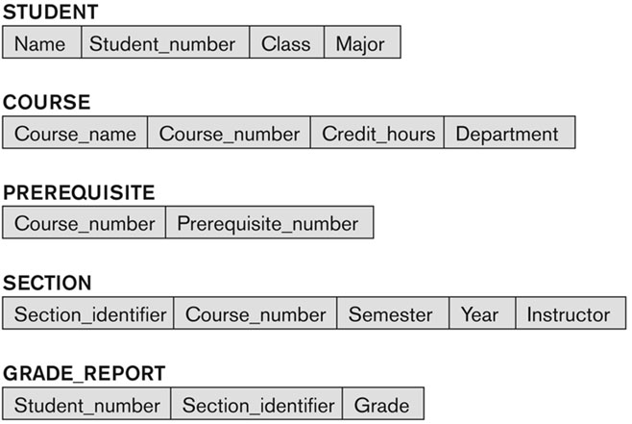
Example of a Database Schema
Figure 2.1 Schema diagram for the database in Figure 1.2.

Slide 11
Example of a Database State (1 of 4)
Figure 1.2 A database that stores student and course information.
COURSE
Course_name | Course_number | Credit_hours | Department
Intro to Computer Science | CS1310 | 4 | CS
Data Structures | CS3320 | 4 | CS
Discrete Mathematics | MATH2410 | 3 | MATH
Database | CS3380 | 3 | CS

Slide 12
Example of a Database State (2 of 4)
Figure 1.2 A database that stores student and course information.
SECTION
Section_identifier | Course_number | Semester | Year | Instructor
85 | MATH2410 | Fall | 04 | King
92 | CS1310 | Fall | 07 | Anderson
102 | CS3320 | Spring | 05 | Knuth
112 | MATH2410 | Fall | 05 | Chang
119 | CS1310 | Fall | 05 | Anderson
135 | CS3380 | Fall | 05 | Stone

Slide 13
Example of a Database State (3 of 4)
Figure 1.2 A database that stores student and course information.
GRADE_REPORT
Student_number | Section_identifier | Grade
17 | 112 | B
17 | 119 | C
8 | 85 | A
8 | 92 | A
8 | 102 | B
8 | 135 | A

Slide 14
Example of a Database State (4 of 4)
Figure 1.2 A database that stores student and course information.
PREREQUISITE
Course_number | Prerequisite_number
CS3380 | CS3320
CS3380 | MATH2410
CS3320 | CS1310

Slide 15
Three-Schema Architecture (1 of 3)
Proposed to support D B M S characteristics of:
Program-data independence.
Support of multiple views of the data.
Not explicitly used in commercial D B M S products, but has been useful in explaining database system organization

Slide 16
Three-Schema Architecture (2 of 3)
Defines D B M S schemas at three levels:
Internal schema at the internal level to describe physical storage structures and access paths (e.g indexes).
Typically uses a physical data model.
Conceptual schema at the conceptual level to describe the structure and constraints for the whole database for a community of users.
Uses a conceptual or an implementation data model.
External schemas at the external level to describe the various user views.
Usually uses the same data model as the conceptual schema.

Slide 17
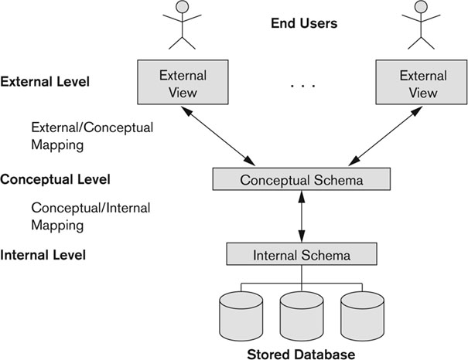
Figure 2.2 The Three-Schema Architecture

Slide 18
Three-Schema Architecture (3 of 3)
Mappings among schema levels are needed to transform requests and data.
Programs refer to an external schema, and are mapped by the D B M S to the internal schema for execution.
Data extracted from the internal D B M S level is reformatted to match the user’s external view (e.g. formatting the results of an S Q L query for display in a Web page)

Slide 19
Data Independence (1 of 2)
Logical Data Independence:
The capacity to change the conceptual schema without having to change the external schemas and their associated application programs.
Physical Data Independence:
The capacity to change the internal schema without having to change the conceptual schema.
For example, the internal schema may be changed when certain file structures are reorganized or new indexes are created to improve database performance

Slide 20
Data Independence (2 of 2)
When a schema at a lower level is changed, only the mappings between this schema and higher-level schemas need to be changed in a D B M S that fully supports data independence.
The higher-level schemas themselves are unchanged.
Hence, the application programs need not be changed since they refer to the external schemas.

Slide 21
D B M S Languages (1 of 3)
Data Definition Language (D D L)
Data Manipulation Language (D M L)
High-Level or Non-procedural Languages: These include the relational language S Q L
May be used in a standalone way or may be embedded in a programming language
Low Level or Procedural Languages:
These must be embedded in a programming language

Slide 22
D B M S Languages (2 of 3)
Data Definition Language (D D L):
Used by the D B A and database designers to specify the conceptual schema of a database.
In many D B M S s, the D D L is also used to define internal and external schemas (views).
In some D B M Ss, separate storage definition language (S D L) and view definition language (V D L) are used to define internal and external schemas.
S D L is typically realized via D B M S commands provided to the D B A and database designers

Slide 23
D B M S Languages (3 of 3)
Data Manipulation Language (D M L):
Used to specify database retrievals and updates
D M L commands (data sublanguage) can be embedded in a general-purpose programming language (host language), such as C O B O L, C, C++, or Java.
A library of functions can also be provided to access the D B M S from a programming language
Alternatively, stand-alone D M L commands can be applied directly (called a query language).

Slide 24
Types of D M L
High Level or Non-procedural Language:
For example, the S Q L relational language
Are “set”-oriented and specify what data to retrieve rather than how to retrieve it.
Also called declarative languages.
Low Level or Procedural Language:
Retrieve data one record-at-a-time;
Constructs such as looping are needed to retrieve multiple records, along with positioning pointers.

Slide 25
D B M S Interfaces
Stand-alone query language interfaces
Example: Entering S Q L queries at the D B M S interactive S Q L interface (e.g. S Q L *Plus in ORACLE)
Programmer interfaces for embedding D M L in programming languages
User-friendly interfaces
Menu-based, forms-based, graphics-based, etc.
Mobile Interfaces: interfaces allowing users to perform transactions using mobile apps

Slide 26
D B M S Programming Language Interfaces
Programmer interfaces for embedding D M L in a programming languages:
Embedded Approach: e.g embedded S Q L (for C, C++, etc.), S Q L J (for Java)
Procedure Call Approach: e.g. J D B C for Java, O D B C (Open Databse Connectivity) for other programming languages as A P I’s (application programming interfaces)
Database Programming Language Approach: e.g. ORACLE has P L/S Q L, a programming language based on S Q L; language incorporates S Q L and its data types as integral components
Scripting Languages: P H P (client-side scripting) and Python (server-side scripting) are used to write database programs.

Slide 27
User-Friendly D B M S Interfaces
Menu-based (Web-based), popular for browsing on the web
Forms-based, designed for naïve users used to filling in entries on a form
Graphics-based
Point and Click, Drag and Drop, etc.
Specifying a query on a schema diagram
Natural language: requests in written English
Combinations of the above:
For example, both menus and forms used extensively in Web database interfaces

Slide 28
Other D B M S Interfaces
Natural language: free text as a query
Speech : Input query and Output response
Web Browser with keyword search
Parametric interfaces, e.g., bank tellers using function keys.
Interfaces for the D B A:
Creating user accounts, granting authorizations
Setting system parameters
Changing schemas or access paths

Slide 29
Database System Utilities
To perform certain functions such as:
Loading data stored in files into a database. Includes data conversion tools.
Backing up the database periodically on tape.
Reorganizing database file structures.
Performance monitoring utilities.
Report generation utilities.
Other functions, such as sorting, user monitoring, data compression, etc.

Slide 30
Other Tools (1 of 2)
Data dictionary / repository:
Used to store schema descriptions and other information such as design decisions, application program descriptions, user information, usage standards, etc.
Active data dictionary is accessed by D B M S software and users/D B A.
Passive data dictionary is accessed by users/D B A only.

Slide 31
Other Tools (2 of 2)
Application Development Environments and C A S E (computer-aided software engineering) tools:
Examples:
PowerBuilder (Sybase)
JBuilder (Borland)
JDeveloper 10G (Oracle)

Slide 32
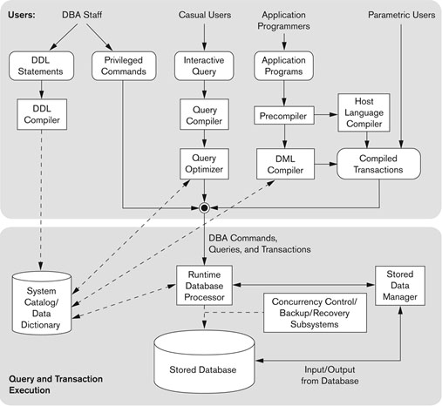
Typical D B M S Component Modules
Figure 2.3 Component modules of a D B M S and their interactions.

Slide 33
Centralized and Client-Server D B M S Architectures
Centralized D B M S:
Combines everything into single system including- D B M S software, hardware, application programs, and user interface processing software.
User can still connect through a remote terminal – however, all processing is done at centralized site.

Slide 34
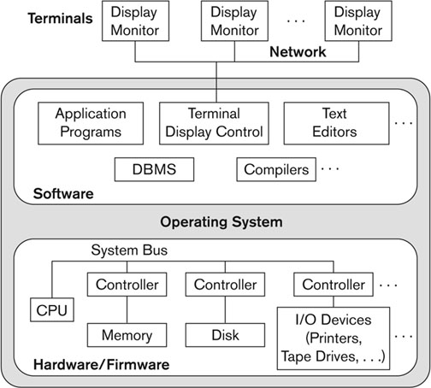
Figure 2.4 A Physical Centralized Architecture

Slide 35
Basic 2-Tier Client-Server Architectures
Specialized Servers with Specialized functions
Print server
File server
D B M S server
Web server
Email server
Clients can access the specialized servers as needed

Slide 36
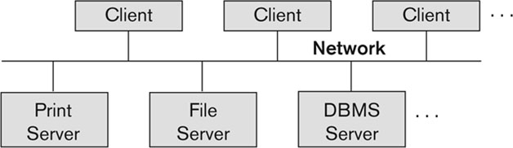
Figure 2.5 Logical Two-Tier Client Server Architecture

Slide 37
Clients
Provide appropriate interfaces through a client software module to access and utilize the various server resources.
Clients may be diskless machines or P C s or Workstations with disks with only the client software installed.
Connected to the servers via some form of a network.
(L A N: local area network, wireless network, etc.)

Slide 38
D B M S Server
Provides database query and transaction services to the clients
Relational D B M S servers are often called S Q L servers, query servers, or transaction servers
Applications running on clients utilize an Application Program Interface (A P I) to access server databases via standard interface such as:
O D B C: Open Database Connectivity standard
J D B C: for Java programming access

Slide 39
Two Tier Client-Server Architecture
Client and server must install appropriate client module and server module software for O D B C or J D B C
A client program may connect to several D B M S s, sometimes called the data sources.
In general, data sources can be files or other non-D B M S software that manages data.
See Chapter 10 for details on Database Programming

Slide 40
Three Tier Client-Server Architecture
Common for Web applications
Intermediate Layer called Application Server or Web Server:
Stores the web connectivity software and the business logic part of the application used to access the corresponding data from the database server
Acts like a conduit for sending partially processed data between the database server and the client.
Three-tier Architecture Can Enhance Security:
Database server only accessible via middle tier
Clients cannot directly access database server
Clients contain user interfaces and Web browsers
The client is typically a P C or a mobile device connected to the Web

Slide 41
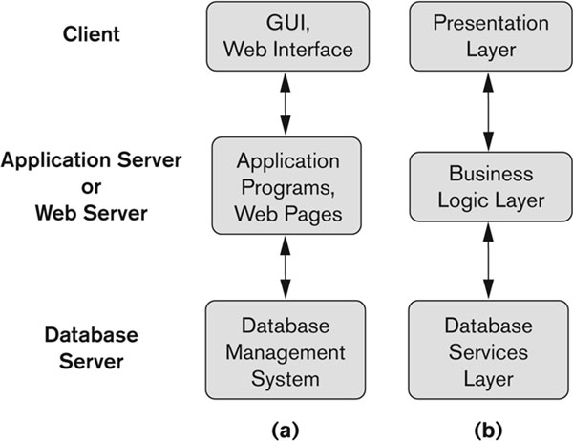
Three-Tier Client-Server Architecture
Figure 2.7 Logical three-tier client/server architecture, with a couple of commonly used nomenclatures.

Slide 42
Classification of D B M S s
Based on the data model used
Legacy: Network, Hierarchical.
Currently Used: Relational, Object-oriented, Object-relational
Recent Technologies: Key-value storage systems, N O S Q L systems: document based, column-based, graph-based and key-value based. Native X M L D B M S s.
Other classifications
Single-user (typically used with personal computers) versus multi-user (most D B M S s).
Centralized (uses a single computer with one database) versus distributed (multiple computers, multiple D B s)

Slide 43
Variations of Distributed D B M S s (D D B M S s)
Homogeneous D D B M S
Heterogeneous D D B M S
Federated or Multidatabase Systems
Participating Databases are loosely coupled with high degree of autonomy.
Distributed Database Systems have now come to be known as client-server based database systems because:
They do not support a totally distributed environment, but rather a set of database servers supporting a set of clients.

Slide 44
Cost Considerations for D B M S s
Cost Range: from free open-source systems to configurations costing millions of dollars
Examples of free relational D B M S s: My S Q L, PostgreS Q L, others
Commercial D B M S s offer additional specialized modules, e.g. time-series module, spatial data module, document module, X M L module
These offer additional specialized functionality when purchased separately
Sometimes called cartridges (e.g., in Oracle) or blades
Different licensing options: site license, maximum number of concurrent users (seat license), single user, etc.

Slide 45
Other Considerations
Type of access paths within database system
E.g.- inverted indexing based (A D A B A S is one such system).Fully indexed databases provide access by any keyword (used in search engines)
General Purpose versu s Special Purpose
E.g.- Airline Reservation systems or many others-reservation systems for hotel/car etc. Are special purpose O L T P (Online Transaction Processing Systems)

Slide 46
History of Data Models (Additional Material)
Network Model
Hierarchical Model
Relational Model
Object-oriented Data Models
Object-Relational Models

Slide 47
History of Data Models
Network Model:
The first network D B M S was implemented by Honeywell in 1964-65 (I D S System).
Adopted heavily due to the support by C O D A S Y L (Conference on Data Systems Languages) (C O D A S Y L – D B T G report of 1971).
Later implemented in a large variety of systems – I D M S (Cullinet - now Computer Associates), D M S 1100 (Unisys), IMAGE (H.P. (Hewlett-Packard)), V A X - D B M S (Digital Equipment Corp., next C O M P A Q, now H.P.).

Slide 48
Network Model (1 of 2)
Advantages:
Network Model is able to model complex relationships and represents semantics of add/delete on the relationships.
Can handle most situations for modeling using record types and relationship types.
Language is navigational; uses constructs like FIND, FIND member, FIND owner, FIND NEXT within set, GET, etc.
Programmers can do optimal navigation through the database.

Slide 49
Network Model (2 of 2)
Disadvantages:
Navigational and procedural nature of processing
Database contains a complex array of pointers that thread through a set of records.
Little scope for automated “query optimization”

Slide 50
History of Data Models (1 of 4)
Hierarchical Data Model:
Initially implemented in a joint effort by I B M and North American Rockwell around 1965. Resulted in the I M S family of systems.
I B M’s I M S product had (and still has) a very large customer base worldwide
Hierarchical model was formalized based on the I M S system
Other systems based on this model: System 2k (S A S i n c.)

Slide 51
Hierarchical Model
Advantages:
Simple to construct and operate
Corresponds to a number of natural hierarchically organized domains, e.g., organization (“o r g”) chart
Language is simple:
Uses constructs like GET, GET UNIQUE, GET NEXT, GET NEXT WITHIN PARENT, etc.
Disadvantages:
Navigational and procedural nature of processing
Database is visualized as a linear arrangement of records
Little scope for “query optimization”

Slide 52
History of Data Models (2 of 4)
Relational Model:
Proposed in 1970 by E.F. Codd (I B M), first commercial system in 1981-82.
Now in several commercial products (e.g. D B 2, ORACLE, M S S Q L Server, S Y B A S E, I N F O R M I X).
Several free open source implementations, e.g. My S Q L, Postgre S Q L
Currently most dominant for developing database applications.
S Q L relational standards: S Q L-89 (S Q L1), S Q L-92 (S Q L 2), S Q L-99, S Q L3, …
Chapters 5 through 11 describe this model in detail

Slide 53
History of Data Models (3 of 4)
Object-oriented Data Models:
Several models have been proposed for implementing in a database system.
One set comprises models of persistent O-O Programming Languages such as C++ (e.g., in OBJECTSTORE or VERSANT), and Smalltalk (e.g., in GEMSTONE).
Additionally, systems like O 2, O R I O N (at M C C - then I T A S C A), I R I S (at H.P.- used in Open O O D B).
Object Database Standard: O D M G-93, O D M G-version 2.0, O D M G-version 3.0.
Chapter 12 describes this model.

Slide 54
History of Data Models (4 of 4)
Object-Relational Models:
The trend to mix object models with relational was started with Informix Universal Server.
Relational systems incorporated concepts from object databases leading to object-relational.
Exemplified in the versions of Oracle, D B 2, and S Q L Server and other D B M S s.
Current trend by Relational D B M S vendors is to extend relational D B M S s with capability to process X M L, Text and other data types.
The term “Object-relational” is receding in the marketplace.

Slide 55
Chapter Summary
Data Models and Their Categories
Schemas, Instances, and States
Three-Schema Architecture
Data Independence
D B M S Languages and Interfaces
Database System Utilities and Tools
Database System Environment
Centralized and Client-Server Architectures
Classification of D B M S s
History of Data Models

Slide 56

Copyright

